Slide 1
OPERATING SYSTEM
Inter Process Communication

Slide 2
DEFINITION
Inter-process communication (IPC) serves as a means for transmitting data among multiple threads situated within one or more processes or programs. These processes may be active on a solitary computer or distributed across a network of machines.

Slide 3
METHODS OF IPC
Pipes
Message Queues
FIFO
Shared Memory
Message Passing
Direct Communication
Indirect Communication

Slide 4
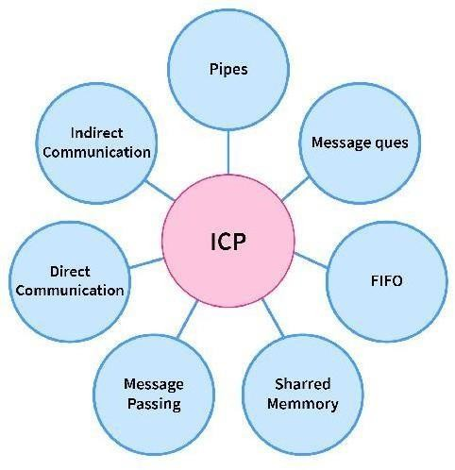
Inter Process Communication

Slide 5
Pipes: It is a half-duplex method (or one-way communication)
Message Queues: We have a linked list to store messages in a kernel of OS and a message queue is identified using "message queue identifier".
FIFO: Used to communicate between two processes that are not related. Full-duplex method -Process P1 is able to communicate with Process P2, and vice versa.
Shared Memory: Multiple processes can access a common shared memory. Multiple processes communicate by shared memory, where one process makes changes at a time and then others view the change. Shared memory does not use kernel.

Slide 6
Message Passing: In IPC, this is used by a process for communication and synchronization. It has two actions sending (fixed size message) and receiving messages.
Direct Communication: In this, processes that wanna communicate must name the sender or receiver.
Indirect Communication: Pairs of communicating processes have shared mailboxes.

Slide 7
THANK YOU

