Slide 1
DIFFERENTIAL THERMAL ANALYSIS
B.Madhavi
Asst.Professor
Dept.of P.G.Chemistry
D.N.R.College
Bhimavaram

Slide 2
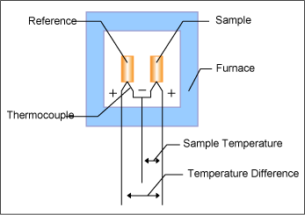
Differential Thermal Analysis (DTA)
Principle:
The basic principle involved in DTA is the temperature difference (∆T) between the test sample and an inert
reference sample under controlled
and identical is recorded
conditions of heating or cooling
continuously as a function of temperature or time, thus the heat absorbed or emitted by a chemical system is determined.

Slide 3
If any reaction takes place in the sample, then the temperature difference will occur between the sample and the reference material.
In an endothermic change (such as melting or dehydration of the sample)
the temperature of the sample is lower than that of the reference material (i.e) ∆T = -ve (for endothermic process)
In an exothermic change or process the sample temperature is higher than that of the reference material. • (i.e) ∆T = + ve (exothermic process)

Slide 4
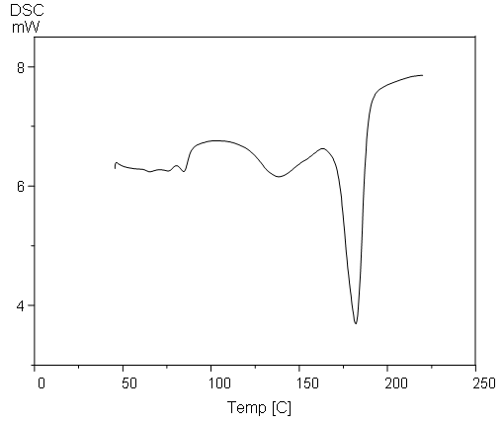
The shape and the size of the peak give information about the nature of the test sample.
Sharp endothermic peaks indicate phase changes (such as melting, fusion etc.) transition from one
crystalline form to another crystalline form.
Broad endothermic peaks are obtained from dehydration reactions
Chemical reactions like oxidative reactions are exothermic reactions.

Slide 5
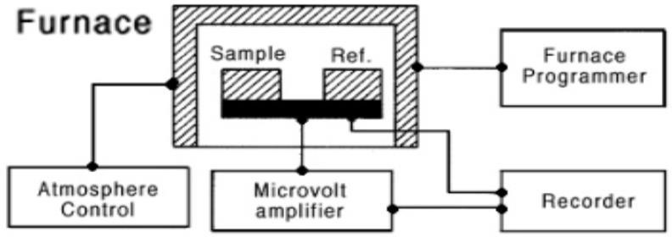
Instrumentation for DTA :Block Diagram
The DTA apparatus consists of the following components
Furnace sample and reference holder with thermocouple assembly.
Sample holder furnace : To heat the sample
Furnace temperature controller: To increase the furnace temperature steadily
Furnace atmospheric control system: To maintain a suitable atmosphere in the furnace and sample holder)
Low level DC amplifier
Recording device(Recorder)
Differential temperature sensor: to measure the temperature difference between the sample and reference material) the sample and reference holder are kept inside the furnace and the temperature of the furnace and sample holder is controlled by using furnace controller.

Slide 6
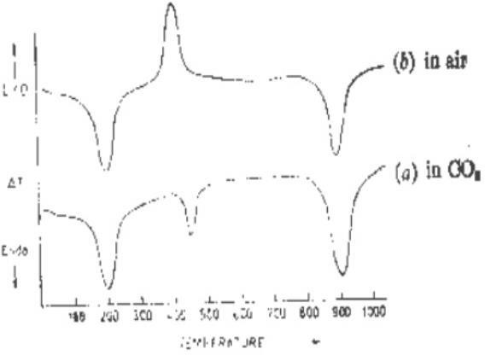
DTA of calcium oxalate monohydrate
The DTA curve for the decomposition of calcium oxalate monohydrate
(CaC₂O₄.H₂O) is shown in the diagram.
The thermogram shows the decomposition in CO₂ atmosphere and in air
atmosphere.

Slide 7
DTA of calcium oxalate monohydrate
The thermogram of calcium oxalate monohydrate has three peaks corresponding to the successive elimination of H₂O, CO and CO₂.These three points of weight loss corresponds to the three endothermic process.
Curve (b) represents the DTA diagram for the same compound in air. The second peak in this curve is sharply exothermic, but corresponds to the same weight loss as in carbon dioxide atmosphere.
This peak represents the exothermic burning of carbon monoxide in air at
the temperature of the furnace.

Slide 8
Factors affecting the DTA Curve
Instrumental Factors:
Size and shape of the sample and furnace holder.
Material from which sample holder is made and its corrosive attack.
Heating rate(furnace heating rate)
Sample characteristics:
Amount of the sample(sample weight)
Particle size of the sample

Slide 9
Applications of DTA
DTA curves for two substances are not identical. Hence they serve as finger
prints for various substances.
Used to study the characteristic of polymeric material.
This technique is used for testing the purity of the drug sample and also to test the quality control of number of substances like cement, soil, glass,etc.
Used for the determination of heat of reaction, specific heat and energy
change occurring during melting etc.
Trend in ligand stability (thermal stability of the ligands) gives the information about the ligands in the coordination sphere.

Slide 10
Thank you

