Slide 1
ION EXCHANGE CHROMATOGRAPHY
T. Mounica
Dept of PG Chemistry
DNR College,
Bhimavaram.

Slide 3
INTRODUCTION:-
“Ion exchange chromatography may be defined as the reversible exchange of ions in the solution with ions electrostatically bound to some sort of insoluble matrix or a stationary phase.”
This technique is extremely useful in the separation of charge compounds like
proteins differing by only one charged amino acid.
In Ion exchange chromatography technique one can choose whether to bind the substance of interest and allow the contamination to pass through the column and vice versa.
This technique has been developing since 19th century which was firstly used
for purifying the drinking water.
Ion exchange chromatography is a distinct principle of chromatography performed in the column

Slide 4
TYPES LABORATORY COMMERCIAL AUTOMATED:-

Slide 5
PRINCIPLE:-
Ion exchange chromatography relies on the attraction between oppositely
charged stationary phase, known as an ion exchanger, and analyte.
The ion exchanger consists of an inert support medium coupled covalently to positive (anion exchanger) or negative (cation exchanger) functional groups.
To these covalently bound functional groups the oppositely charged ions are bounded (mobile counter ion), which will be exchanged with like charge ions in the sample having charge magnitude more than the ions bounded to the matrix.
Thus if anion exchange chromatography is performed, negatively charged sample components will interact more with the stationary phase and will be exchanged for like charged ions already bounded to the matrix

Slide 6
WORKING:-
Consider a column having E⁻ Y⁺ cation exchanger in which E ⁻ isnegative charged exchanger and Y⁺ is the mobile counter ion.
Let X⁺ be the cation in the sample having charge greater than Y⁺ .
The X⁺ ion can exchange sites with the counter ion Y⁺ with satisfying the
following relationship;
The remaining neutral
_{E} - _{Y}+ _{X}+ _{E} - _{X}+ _{Y}+
+
→
and negatively charged particles
Desired bounded cation (X+ ) can now be eluted by either of the two ways;
By adding a component M+ having magnitude of charge more than that of X+ so that M+ will replace X+ and X+ will be eluting out.
By changing pH of the solvent (mobile phase so that X+ have no charge and is then unbounded from the matrix and can be eluted out.

Slide 8
WORKING PRINCIPLE:-
The 4 basic steps of ion exchange chromatography:-
Equilibration
Sample application and wash
Elution
Regeneration

Slide 12
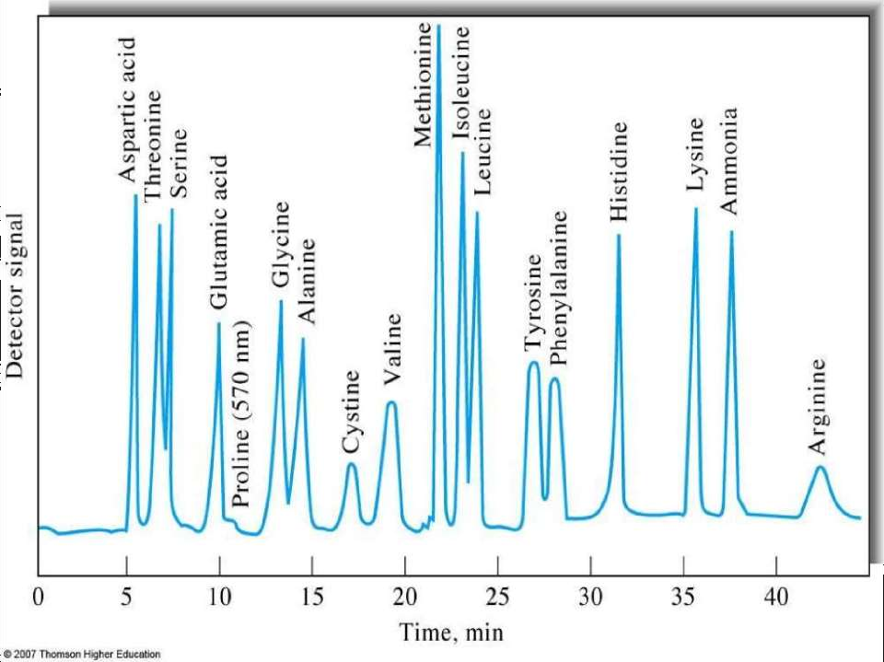

Slide 13
REQUIREMENT:-
Column :-
glass, stainless steel or polymers
Packing the column :-
Wet packing method: A slurry is prepared of the eluent with the stationary phase powder and then carefully poured into the column. Care must be taken to avoid air bubbles.
Application of the sample:-
After packing, sample is added to the top of the stationary phase, use syringe or pipette.
This layer is usually topped with a small layer of sand or with cotton or glass wool to protect the shape of the organic layer from the velocity of newly added eluent.
Continue...

Slide 14
4.Mobile phase:- Acids, alkalis, buffers.
Stationary phase:-
The ionic compound consisting of the cationic species (M+) and the anionic species (B-)
Elution:-
Components of mixture separate & move down the column at different rates depending upon the affinity of the ion for ion exchanger.
The eluates are collected at different stages
7. Analysis of the eluate:-
Spectrophotometric, flame photometry polarographic, conductometri.

Slide 16
Ion Exchange Resin:
The swelling factor and cross linking is important for the effective separation. The cross linking should be controlled as its affects the exchanger’s capacity. Swelling helps in proper exposure of charged functional groups for exchange of ions.
swells less → separation of ions of different sizes is difficult.
Nature of exchanging ions:
valency of ions.
Size of ions
Polarizability
Concentration of solution.
Concentration & charge of ions
C . pH of the mobile phase
D . Ionic strength
E . Mobile phase modifiers
F . Temperature
G. Buffer: The pH of the buffer should impart the same charge to the sample ions as present in the Column. Anionic Exchange Chromatography should be carried out with cationic buffers and vice versa because buffer ion will indulge in ion exchange, which will be of no use.

Slide 17
ION EXCHANGERS:-
There are three classes of ion exchangers
1. Resins:- Ion exchange resins are used for the separation of small molecules
2. Gels:- Ion exchange gels are used for the separation of large molecules like
,nucleic acids
proteins
3. Inorganic exchangers:- Separations involving harsh chemical conditions(high temperature , high radiation levels, strongly basic solutions or powerful oxidizing agents) employ inorganic ion exchangers

Slide 18
CLASSIFICATION OF ION EXCHANGE RESINS:-
According to the chemical nature they classified as-
Strongly acidic cation exchanger:-
sulphonic acid groups attached to styrene and divinyl-benzene copolymer.
Weakly acidic cation exchanger:-
carboxylic acid groups attached to acrylic and divinyl-benzene co-polymer.
Strongly basic anion exchanger:-
quaternary ammonium groups attached to styrene and divinyl-benzene co-polymer.
Weakly basic anion exchanger:-
poly alkyl amine groups attached to styrene and divinyl benzene co- polymer.

Slide 19
ACCORDING TO THE SOURCE:-
Natural resins :
Cation - Zeolytes, Clay
Anion - Dolomite
Synthetic resins: Inorganic & Organic resins
Organic resins:- are polymeric resin matrix.

Slide 20
ION EXCHANGE RESIN:-
Resins are amorphous particles of organic materials
Polystyrene resins for ion exchange are made by co- polymerization of styrene and divinyl-benzene.
Divinyl-benzene content is varied from 1 to 16 percent to increasethe
extent of cross linking.
Benzene groups are modified to produce cation exchange resin and anion exchange resin
Resin made from both of these materials differ in their flow properties, ion
accessibility, and chemical and mechanical stability.
Selection of one or the other type of resin is done on the basis of compounds being separated

Slide 21
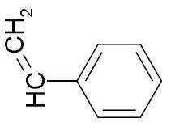
POLYSTYRENE RESINS:-
Polystyrene resins are prepared by polymerisation reaction of styrene and divinyl-benzene.
Higher concentration of divinyl-benzene produces higher cross linkages.
Polystyrene resin are very useful for separating small molecular weight compounds, however, unsatisfactory for the separation of macromolecules
styrene
divinylbenzene

Slide 22
ION EXCHANGE GELS:-
Cellulose and dextran ion exchangers , which are polymers of the sugar glucose , posses larger pore sizes and lower charge densities.
Because they are much softer than polystyrene resins , dextran and its
relatives are called gels .

Slide 23
EXCHANGE MEDIUM
The choice of ion exchangers depends upon the stability, molecular weight,
and ionic strength of the sample components.
The volume of exchanger used for separation is usually 2.5 fold greater than to exchange with the ion in the sample.
The ion exchanger are packed in column having suitable buffer.
The ion exchangers are of two types;
Cation Exchangers Anion Exchangers

Slide 26
Anion and cation Exchangers

Slide 27
ADVANTAGES
Cost effective
Re-usable
Easily collectable
Low maintenance cost
Efficient technique
Quick separation

Slide 28
APPLICATIONS
Softening of hard water
Demineralization of water
To analyze base composition of nucleic acid
To concentrate the metal ions in the sample
To measure the additives in food and drug sample
To separate protein mixtures
For extraction of enzymes from tissues.
Purification of solutions free from ionic impurities.
Separation of inorganic ions.
Separation of sugars, amino acids and proteins.
Ion exchange column in HPLC.

Slide 29
THANK YOU

