Slide 1
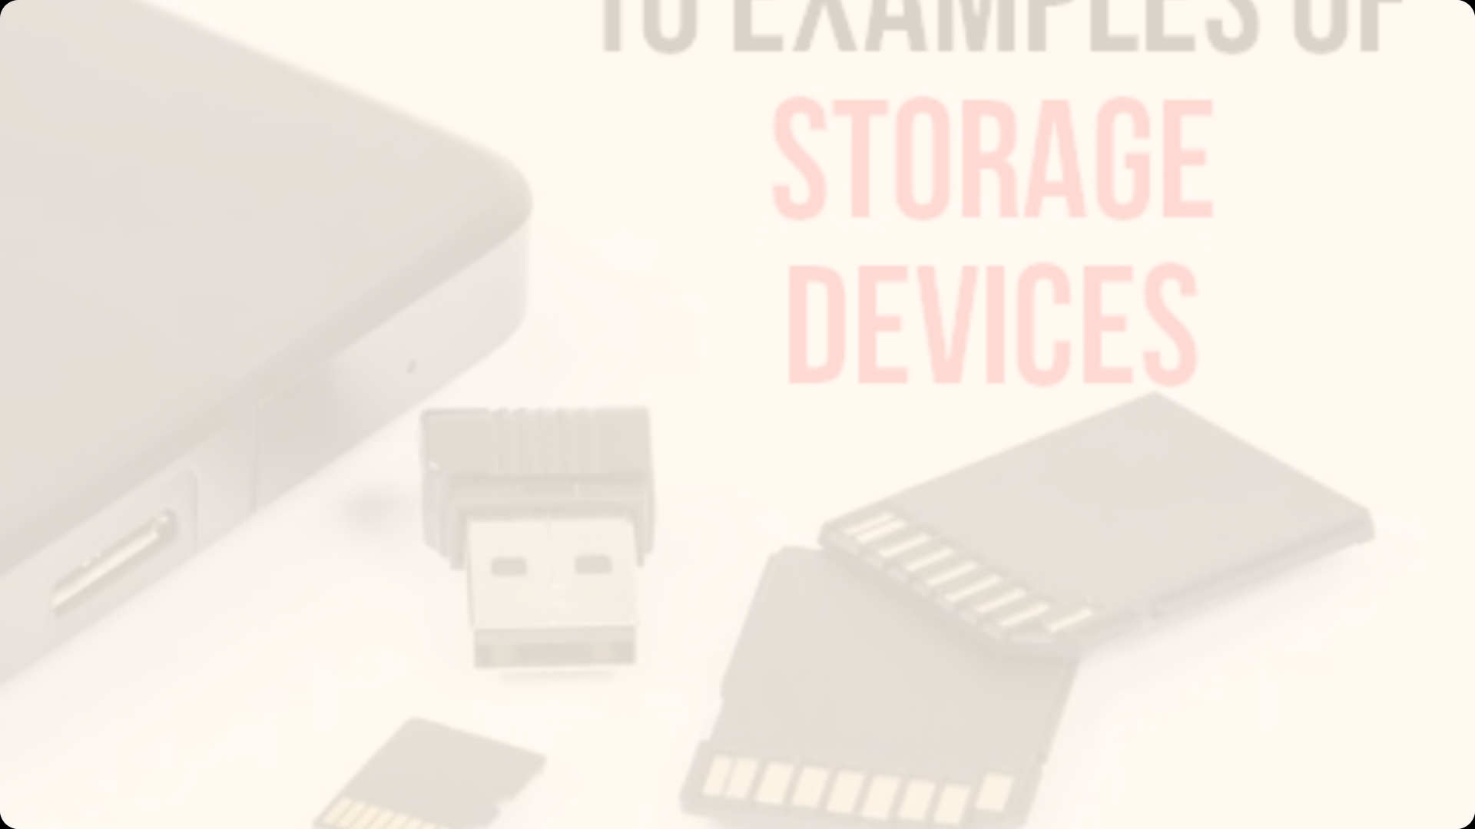
Introduction to Auxiliary Memory
Auxiliary memory, also known as secondary storage, refers to storage devices that provide additional memory capacity beyond a computer's primary memory (RAM). These external storage solutions allow for long-term data retention and expanded data storage capabilities.
Presented by
K.VENKATESH
MCA DEPARTMENT

Slide 2
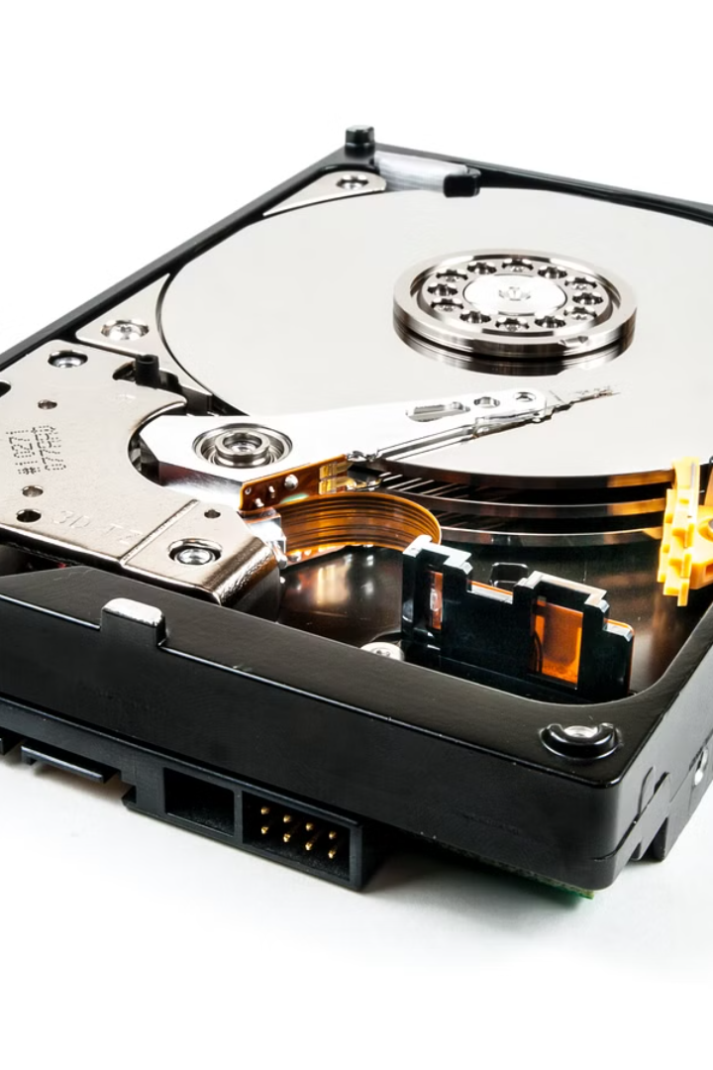
What is Auxiliary Memory?
Auxiliary memory is any type of computer data storage that is not the main memory (RAM) used by the central processing unit (CPU). It provides persistent, non-volatile storage for programs and data that cannot fit in or do not need to be in the computer's main memory.

Slide 3
Types of Auxiliary Memory
1
Hard Disk Drives (HDDs)
2
Solid-State Drives (SSDs)
Magnetic storage devices that use spinning disks to read and write data.
Flash memory-based storage devices with no moving parts, providing faster access times.
3
Optical Discs
4
Removable Media
Data storage on CDs, DVDs, and Blu-ray discs using laser light to read and write.
Portable storage like USB flash drives, memory cards, and external hard drives.

Slide 4
Characteristics of Auxiliary Memory
Large Capacity
Non-Volatile
Slower Access
Auxiliary memory devices can store massive amounts of data, ranging from hundreds of gigabytes to terabytes.
Data stored in auxiliary memory remains intact even when the power is turned off.
Auxiliary memory has slower read/write speeds compared to the main memory (RAM).

Slide 5
Advantages of Auxiliary Memory
Large Capacity
Data Persistence
Cost Effective
Auxiliary memory can store much more data than the computer's primary memory.
Data stored in auxiliary memory remains available even when the computer is turned off.
Auxiliary memory solutions are generally less expensive per gigabyte of storage.

Slide 6
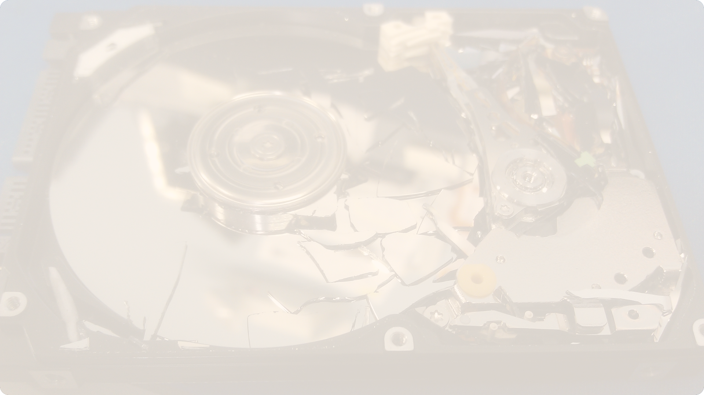
Disadvantages of Auxiliary Memory
Slower Access
Limited Portability
Potential Data Loss
Auxiliary memory has longer access times compared to primary memory, resulting in slower data retrieval.
Most auxiliary memory devices are not as portable as primary memory (RAM).
Auxiliary memory can be susceptible to physical damage, power outages, or software/hardware failures, leading to data loss.

Slide 7
Applications of Auxiliary Memory
Data Archiving
Storing large amounts of infrequently accessed data for long-term preservation.
Backup and Recovery
Providing a secure location to backup important files and enable data recovery.
Multimedia Storage
Storing high-resolution photos, videos, and other large media files.

Slide 8
Conclusion
Auxiliary memory plays a crucial role in modern computing by providing abundant, persistent storage beyond a computer's primary memory. While it offers advantages in capacity and cost-effectiveness, it also has limitations in access speed and portability. Effectively leveraging auxiliary memory is essential for comprehensive data management and long-term preservation.

