Slide 1
Introduction to Computer Registers
Computer registers are high-speed storage units within a CPU that hold data, addresses, and instructions. They act as the brain's temporary memory, enabling rapid access and manipulation of information essential for program execution.
Presented by
K.VENKATESH
MCA DEPARTMENT

Slide 2
Purpose and Function of Registers
1
Data Storage
2
Address Holding
Registers temporarily store the data and results of computations performed by the CPU.
Registers hold the memory addresses required to fetch instructions and data from main memory.
3
Instruction Fetching
4
Arithmetic Operations
Registers retrieve program instructions from memory for execution by the CPU.
Registers facilitate arithmetic and logical operations on data by the CPU's Arithmetic Logic Unit (ALU).

Slide 3
Types of Registers
General-Purpose Registers
Special-Purpose Registers
Control Registers
Used to store data and addresses, accessible by most instructions.
Dedicated to specific functions, such as the program counter and stack pointer.
Manage the CPU's operation, like the status register and memory management unit.

Slide 4
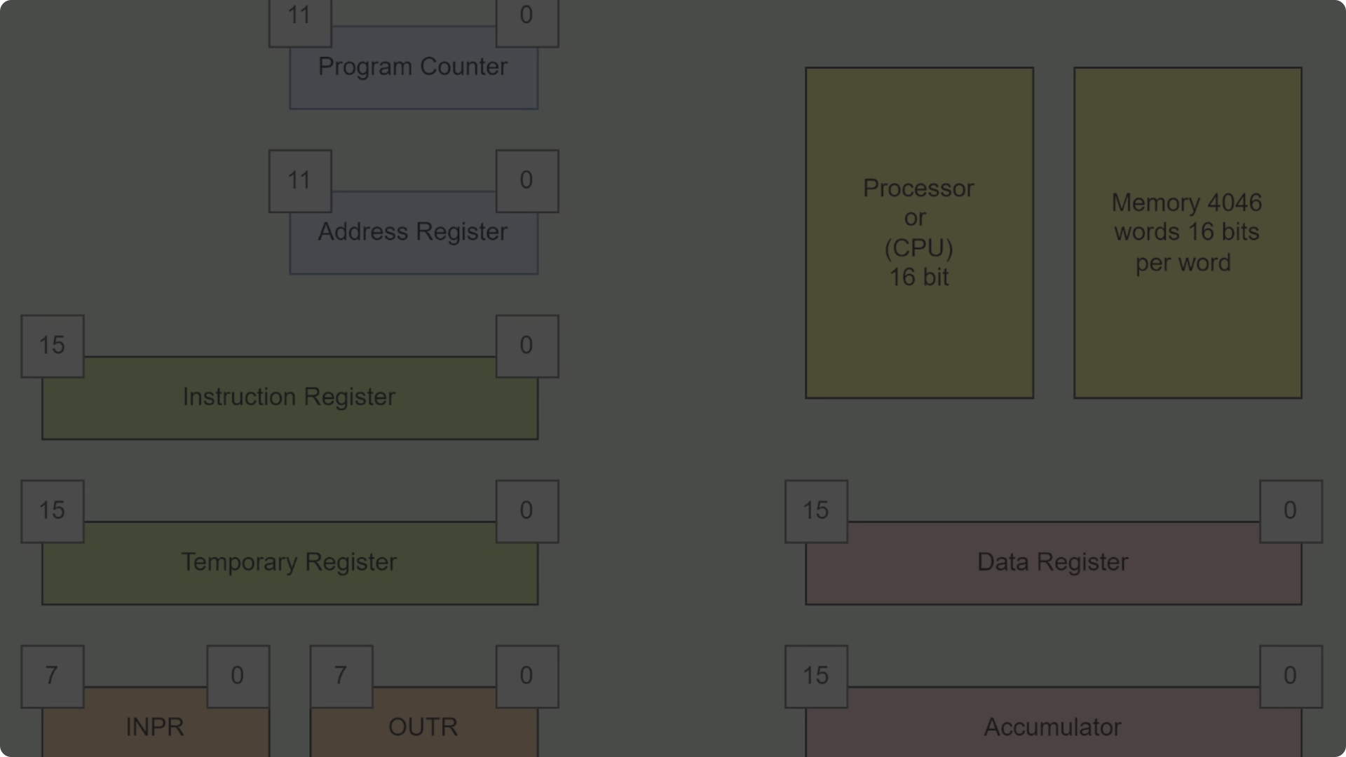
Register Architecture
CPU Register File
Register Bus
Provides fast access to a set of general-purpose registers.
Connects the registers to the CPU's Arithmetic Logic Unit (ALU) and memory.
1
2
3
Register Bank
A collection of specialized registers for specific functions.

Slide 5
Register Addressing Modes
Direct Addressing
Indirect Addressing
The operand is the value stored in the register.
The register contains the memory address of the operand.
Indexed Addressing
Base Addressing
The operand address is the sum of the register and an offset.
The operand address is the sum of a base register and an offset.

Slide 6
Register Allocation and Optimization
Stack Allocation
Graph Coloring
Spilling
Register Renaming
Storing temporary variables in a stack-based memory region.
Assigning registers to variables using graph coloring algorithms.
Storing variables in memory when not enough registers are available.
Dynamically assigning new register names to avoid naming conflicts.

Slide 7
Importance of Efficient Register Usage
Reduced Memory Access
Registers enable faster data retrieval compared to main memory.
Fewer CPU Stalls
Optimized register usage minimizes pipeline stalls and improves performance.
Energy Efficiency
Registers consume less power than repeatedly accessing memory.

Slide 8
Conclusion and Key Takeaways
Registers are the CPU's high-speed temporary storage
Registers enable rapid data access and manipulation
Registers come in various types with specialized functions
Effective register allocation and usage is crucial for performance

