Slide 1
Types of Inheritance in Java
Java inheritance is a fundamental concept that allows a new class to be based on an existing class, inheriting its properties and behaviors. There are several types of inheritance in Java, each with its own unique characteristics and applications.
Presented by
K.VENKATESH
MCA DEPARTMENT

Slide 2
Single Inheritance
Definition
Example
Use Case
Single inheritance occurs when a subclass inherits from a single superclass.
A Dog class inheriting from an Animal class, gaining access to the properties and methods of the Animal class.
Single inheritance is commonly used to build hierarchical class structures, where each subclass adds more specialized functionality to the base class.

Slide 3
Multilevel Inheritance
Chained Inheritance
1
Multilevel inheritance occurs when a subclass inherits from a superclass, which in turn inherits from another superclass.
2
Hierarchical Structure
This creates a hierarchical inheritance structure, where each level adds more specialized functionality.
Flexibility
3
Multilevel inheritance allows for more complex and flexible class hierarchies, enabling code reuse and modularity.

Slide 4
Hierarchical Inheritance
One Superclass, Multiple Subclasses
Shared Functionality
The superclass provides common functionality to its subclasses, promoting code reuse and maintainability.
In hierarchical inheritance, a single superclass has multiple subclasses inheriting from it.
Flexibility
Real-World Examples
Hierarchical inheritance allows for the creation of complex class hierarchies and the implementation of specialized behavior.
Examples include the inheritance hierarchy of animals (mammals, birds, reptiles, etc.) or different types of vehicles (cars, trucks, motorcycles, etc.).

Slide 5
Multiple Inheritance
1
Inheriting from Multiple Superclasses
2
Ambiguity and Conflict Resolution
3
Java Limitations
Java does not support multiple inheritance of classes, but it does support multiple inheritance of interfaces.
In multiple inheritance, a subclass can inherit from more than one superclass.
Multiple inheritance can lead to ambiguity when the subclass inherits conflicting methods or properties from its superclasses.

Slide 6
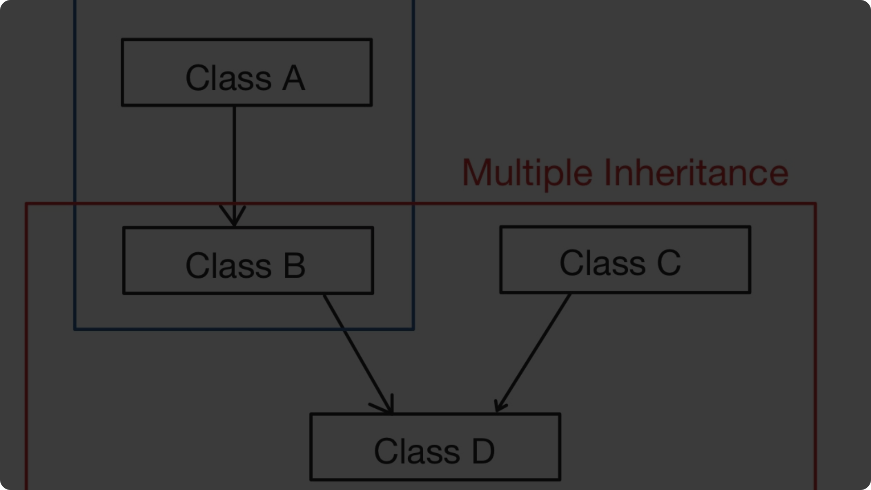
Hybrid Inheritance
Combination of Inheritance Types
Hybrid inheritance combines multiple types of inheritance, such as single and multiple inheritance.
Complexity
Hybrid inheritance can create complex class hierarchies, which can be challenging to design and maintain.
Java Implementation
In Java, hybrid inheritance can be achieved by combining single inheritance and interface implementation.

Slide 7
Method Overriding
Inheritance
Overriding
Polymorphism
Method overriding occurs when a subclass provides its own implementation of a method inherited from a superclass.
The subclass method must have the same name, return type, and parameter list as the superclass method.
Method overriding enables polymorphism, allowing objects of different classes to be treated as objects of a common superclass.

Slide 8
Advantages of Inheritance
1
Code Reuse
2
Polymorphism
Inheritance promotes code reuse, as subclasses can inherit and utilize the code from their superclasses.
Inheritance enables polymorphism, allowing objects of different classes to be treated as objects of a common superclass.
3
Modularity
4
Flexibility
Inheritance supports modularity, as changes in the superclass can be automatically propagated to its subclasses.
Inheritance allows for the creation of complex and flexible class hierarchies, enabling the development of more robust and scalable systems.

