Slide 1
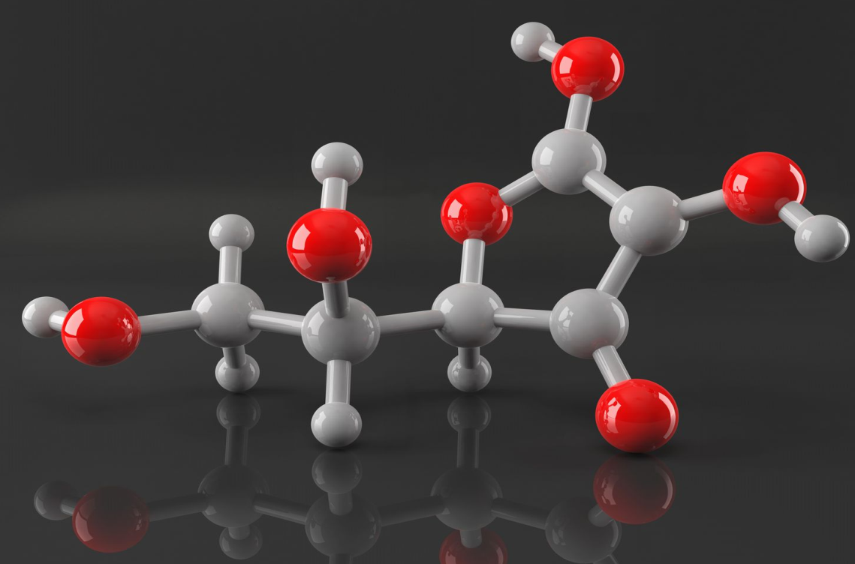
DI ATOMIC MOLECULES
BY
T.KRISHNA KUMARI

Slide 2
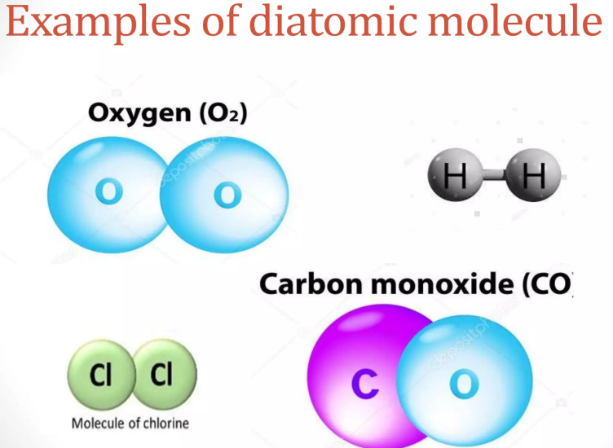
INTRODUCTION
Diatomic molecules are molecules composed of only two atoms, of either the same or different chemical elements. The prefix di-is of Greek origin, meaning “two”.
If a diatomic molecules consists of two atoms of the same element. Such as hydrogen(H₂) or Oxygen (O₂) then it is said to be homonuclear.
If a diatomic molecule consists of two different atoms such as carbon monoxide (CO) or nitric oxide (NO) , the molecule is said to be heteronuclear.

Slide 3
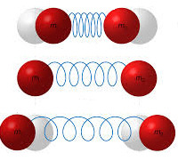
MOLECULAR VIBRATION
A molecular vibration occurs when atoms in a molecule are in periodic motion while the molecule as a whole has constant translational and rotational motion.
The frequency of the periodic motion is known as a vibration frequency.
A diatomic molecule has one normal mode of vibration .
The normal mode of vibration of polyatomic molecules are independent of each other but each normal mode will involve simultaneous vibration of different parts of the molecule such as different chemical bonds.
The motion in a normal vibration can be described as a kind of simple harmonic motion .

Slide 4
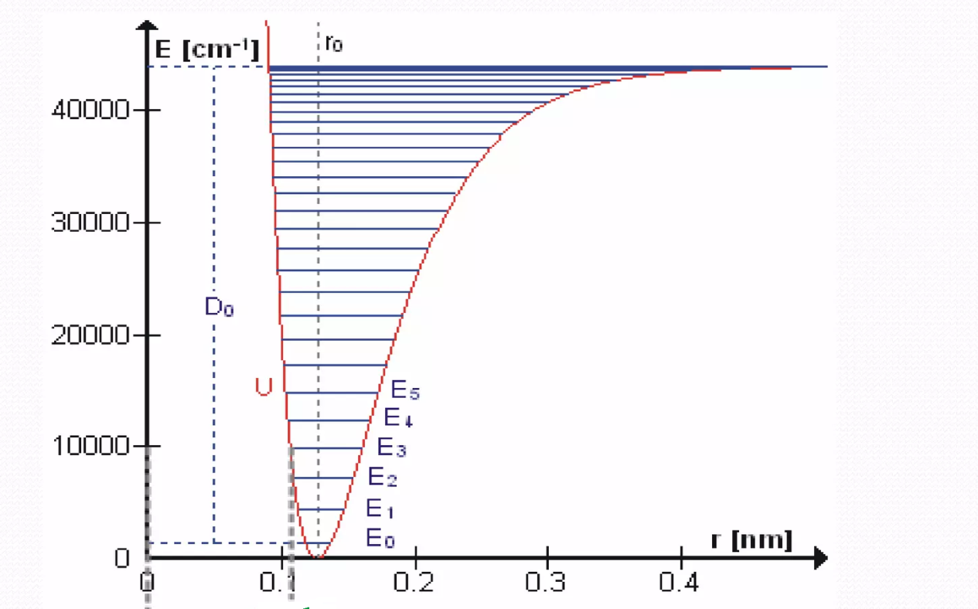

Slide 5
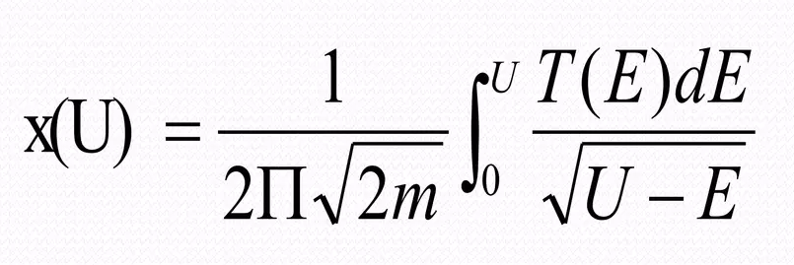
Potential energy from period of Oscillations
Let us Consider a potential well. Assuming that the Curve is Symmetric about the axis the shape of the curve can be implicitly determined from the period of the Oscillations of Particles with energy according to the Formula:

