Slide 1
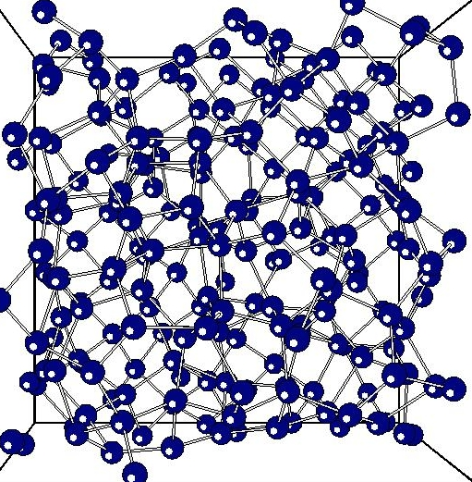
SOLID STATE PHYSICS
BY
T KRISHNA KUMARI

Slide 2
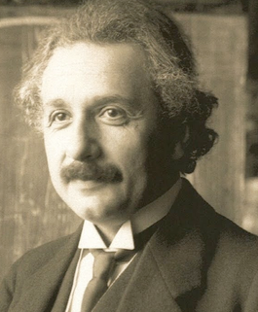
SOLID STATE PHYSICS
HISTORY:
Albert Einstein as the father of solid state physics.
solid state physics is usually said to have begun around the end of World War II. The development of the transistor, based on theories about the electrical properties of semiconductor solids, was announced in 1948.
Semiconductor devices similar to transistors have made possible the construction of tiny electronic circuits.
In 1960 the first laser was developed, based on theories about how solid ruby absorbs and emits light waves. Since then, laser light has been sent to the moon and back, has been used in delicate eye surgery, and has guided the construction of a two-mile-long linear accelerator.

Slide 3
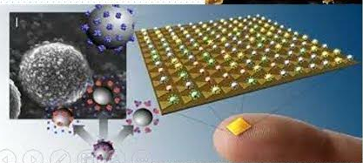
SOLID STATE PHYSICS
INTRODUCTION:
Solid State Physics is explains the properties of solid materials
It explains the properties of a collection of atomic nuclei and electrons interacting with electrostatic forces.
The majority of solids are Crystalline.
Crystalline materials are solids with an atomic structure based on a regular repeated pattern.
It understands the electrical properties of solids is right at the heart of modern society and technology.

Slide 4
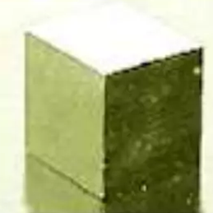
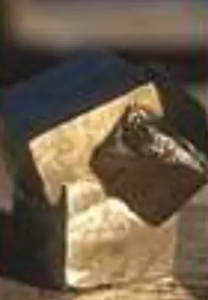
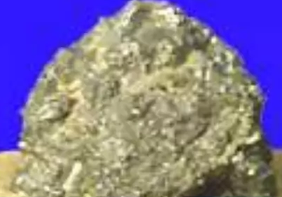
SOLID STATE PHYSICS
Classifications of Solids:
Solid materials are classified in to three states. They are
1. Crystalline- Single Crystal
2.Polycrystalline
3.Amorphous

Slide 5
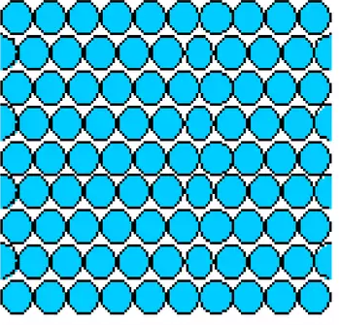
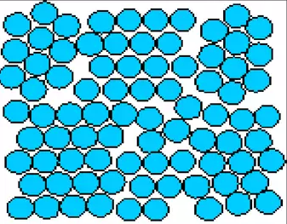
SOLID STATE PHYSICS
Crystalline- Single Crystal:
Single crystals have a periodic atomic Structure across its whole volume.
At long range length scales, each atom is related to every other equivalent atom in the structure by translational or rotational symmetry.
Polycrystalline Solids:
Polycrystalline materials are made up of aggrogate of many small single crystals .
Polycrystalline materials have a high degree of order over many atomic or molecular dimensions.
Grains (domains) are separeted boundaries.The atomic domain order can very from one domain to the next. They are 100nm-100 microns in diameter.

Slide 6
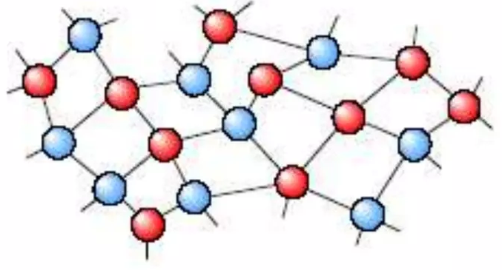
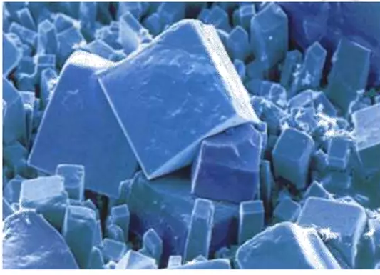
SOLID STATE PHYSICS
Amorphous solids:
Amorphous solids are made up of randomly oriented atoms, ions or molecules that do not form define patterns or Lattice strucures.
Amorphous materials have order only within few atomic or molecular dimensions.
Amorphous materials do not have long-rangr order, but they have varying degrees of short-range order.
Amorphous silicon can be used in solar cells and thin transistors.
Crystallography:
Crystallography is a branch of science that deals with geometric description of crystals and their internal atomic arrangement
It’s important the symmentry of a crysta because it has a profound influence on its properties.
Structures should be classified into different types according to the symmetrics they process.

Slide 7
THANK YOU

