Slide 1
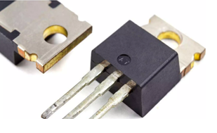
FIELD EFFECT TRANSISTOR
Presented by
G.Sri lakshmi

